Slide 1

Web Accessibility 101
Making Research and Geospatial Applications Inclusive

Slide 2
What will this session cover?

Slide 3
What to expect from this session
No coding!
Concepts, methods, and tools that are programming-language/system agnostic
Interactivity: anonymous polls/Q&A
Using Vevox
Can enter the poll using your laptop or mobile
No login/account required
A lot to absorb
This is a jumping-off point
Links to resources provided in the slides

Slide 4
What to expect from this session
A lot to absorb
This is a jumping-off point
Links to resources provided in the slides
Don’t expect to be an accessibility expert at the end!
Key takeaways:
Web accessibility is a fundamental part of building a good web application;
Be open to advice, suggestions, and critique on web accessibility!

Slide 5
What to expect from this session
Key words and principles for you to search later!
Each framework is different, but hopefully this will focus you on what to search…
“edit CSS Rshiny app”
“Tab focus Python Dash app”
Embed ideas and approaches, and let you find the specifics for your case!

Slide 6
Join the Vevox session
Go to vevox.app Enter the session ID: 176-296-390 Or scan the QR code

Slide 7
Have you opened Vevox successfully?
##/##
Join at: vevox.app
ID: 176-296-390
Question slide
Yes!
0%
Yes again!
0%

Slide 8
Have you opened Vevox successfully?
##/##
Join at: vevox.app
ID: 176-296-390
Results slide
Yes!
0%
Yes again!
0%

Slide 9
Workshop content
What is web accessibility?
Where do we start?
How do we make web applications and maps more accessible?
How do we test our maps/apps for accessibility?
What are some hazards to be aware of?
Where do we learn more?

Slide 10
Workshop content
What is web accessibility?
Where do we start?
How do we make web applications and maps more accessible?
How do we test our maps/apps for accessibility?
What are some hazards to be aware of?
Where do we learn more?

Slide 11
Before we kick off…
Even though we might be all using different frameworks to build web apps, the underlying logic is usually the same
How familiar are you with each of these? HTML, CSS, JS?

Slide 12
Join the Vevox session
Go to vevox.app Enter the session ID: 176-296-390 Or scan the QR code

Slide 13
How familiar are you with each of these?
##/##
Join at: vevox.app
ID: 176-296-390
Question slide
Completely unfamiliar
Very familiar
HTML (Hypertext Markup Language)
CSS (Cascading Style Sheets)
JS (JavaScript)

Slide 14
How familiar are you with each of these?
##/##
Join at: vevox.app
ID: 176-296-390
Results slide
Completely unfamiliar
Very familiar
HTML (Hypertext Markup Language)
CSS (Cascading Style Sheets)
JS (JavaScript)

Slide 15
HTML (Hypertext Markup Language)
Provides the structure and content of web pages
Uses elements like <header>, <nav>, <main> to give meaning to content (semantic meaning)
Screen readers and assistive technologies rely on proper HTML structure
Like the skeleton of a wood-frame house - it defines what goes where

Slide 16
CSS (Cascading Style Sheets)
Controls how content looks and is positioned
Handles colors, fonts, spacing, layout, and responsive design
Can enhance or hinder accessibility through color contrast, font sizes, focus indicators
Like the plasterboard, paint, flooring and general decoration of the house

Slide 17
JavaScript
Interactive layer
Makes web pages dynamic and responsive to user actions
Handles clicks, form submissions, animations, and real-time updates
For accessibility, must work with keyboards, screen readers, and other assistive technologies
Like an electrical system in your house; sometimes even like a smart-home assistant…
Can be very powerful, but also can be insecure!

Slide 18
Using Rshiny, Python etc.
Generate HTML, CSS, and JavaScript behind the scenes
Output standard web technologies
Your R or Python code creates the HTML structure, styling, and interactive behaviours
Even though you write in R or Python, users still interact with HTML/CSS/JS in their browsers
The same accessibility principles apply - your R Shiny or Python app must generate accessible HTML output
They don’t always – we need to check!
Sort of like a turn-key or flat-pack house…

Slide 19
HTML, CSS, JS - Not the only frameworks
Many other web frameworks and tools exist (WebAssembly, WebGL, SVG, etc.)
But! Almost all web applications ultimately rely on these three core technologies
Accessibility best practices apply regardless of the specific technology
What you learn about accessible HTML will help with any framework you use later
Good accessibility starts with understanding the fundamentals, not mastering every possible technology!

Slide 20
Some reading if you haven’t used HTML and CSS
HTML, CSS and JS for Rshiny
HTML and CSS for Python Developers
CSS and JavaScript accessibility best practices
HTML Accessibility: Programming with an Inclusive Perspective

Slide 21
What is web accessibility?
How does web accessibility differ from other uses of the term “accessibility”?

Slide 22
Join the Vevox session
Go to vevox.app Enter the session ID: 176-296-390 Or scan the QR code

Slide 23
What does accessibility mean to you?
##/##
Join at: vevox.app
ID: 176-296-390
Question slide

Slide 24
What does accessibility mean to you?
##/##
Join at: vevox.app
ID: 176-296-390
Results slide

Slide 25
Accessibility
FAIR Data Principles: Findable, Accessible, Interoperable, Reusable
Accessible: (meta)data can be accessed by a user with a standard protocol (e.g. not buried on a laptop, “available upon reasonable request”)
Ensuring data and results can be accessed, understood, and utilised by a wide, non-specialised audience
Broadening participation
Web accessibility
Ensures everyone, including people with disabilities, can perceive, understand, navigate, and interact with the web.
Precise, technical definition
Related reading:
WebAIM: Introduction to Web Accessibility
FAIR Data Principles

Slide 26
A little bit of background
1 in 5 people in the UK have a long-term illness, impairment or disability. Many more have a temporary disability.
Varied and diverse:
Health conditions
Changing abilities
Temporary disabilities
Situational limitations
Related reading:
WebAIM: Introduction to Web Accessibility
Web Accessibility Initiative: Diverse Abilities and Barriers

Slide 27
A little bit of background
Visual (Blindness, low vision, colour-blindness)
Auditory (Deafness, hard-of-hearing)
Motor (response time, dexterity, fine motor control),
Cognitive (learning disabilities, processing, memory).
Related reading:
WebAIM: Introduction to Web Accessibility
Web Accessibility Initiative: Diverse Abilities and Barriers

Slide 28
A little bit of background
I’m not a web development expert!
My experience:
Visual (Low vision, visual disturbances),
Motor (response time, dexterity, fine motor control),
Cognitive (Memory/confusion, processing, aphasia, effect of chronic pain),
Situational.
Adaptations:
Voice notes on Whatsapp
Printing material in large font sizes
Screen-readers
Related reading:
WebAIM: Introduction to Web Accessibility
Web Accessibility Initiative: Diverse Abilities and Barriers

Slide 29
Designing with disability in mind
Other researchers
Collaborators, reviewers, peers
Interested parties and collaborators
Local authorities, councils, police force, medical staff
General public
Students
Who are you excluding by not intentionally designing for disability?
What are you saying about the role of disabled people in society?

Slide 30
Workshop content
What is web accessibility?
Where do we start?
How do we make web applications and maps more accessible?
How do we test our maps/apps for accessibility?
What are some hazards to be aware of?
Where do we learn more?

Slide 31
Where do we start?
The web is an incredible resource that is ever growing; how do we leverage it in an accessible way?

Slide 32
Web Content Accessibility Guidelines (WCAG)
An international set of guidelines – the web accessibility Bible
A useful checklist when building a website
A great resource to reference when trying to decide the best way to implement something
Used by many governments as a required standard
“A developer can learn the basics of web accessibility in just a few days, but, as with any technical skill, it often takes months to internalize the mindset as well as the techniques.” WebAim, Introduction to Web Accessibility
Related reading:
WebAIM: Introduction to Web Accessibility
Web Accessibility Initiative: Diverse Abilities and Barriers

Slide 33
POUR: the 4 principles behind WCAG
Perceivable: can the information be accessed via the browser or assistive technologies?
Operable: can users interact with all elements equally whether using a mouse, the keyboard, or an assistive device?
Understandable: is the content clear, equally understandable whether a user is using assistive technologies, and does it limit confusion and ambiguity?
Robust: does the website work for a wide range of technologies, instead of relying on very specific tech?
Related reading:
WebAIM: Introduction to Web Accessibility
Web Accessibility Initiative: Diverse Abilities and Barriers

Slide 34
What are we aiming for?
For users to get a full experience from our website
Regardless of whether they are using a vanilla browser, or assistive technology
Regardless of whether they are navigating with a mouse, the keyboard, or other assistive technology
For our website to be easy to use and enjoyable to use
To meet all WCAG AA standards at minimum

Slide 35
Workshop content
What is web accessibility?
Where do we start?
How do we make web applications and maps more accessible?
How do we test our maps/apps for accessibility?
What are some hazards to be aware of?
Where do we learn more?

Slide 36
How do we make apps and maps more accessible?
How do we ensure the POUR principles are met?

Slide 37
Making sure your content is perceivable
Sizing
Contrast and colours
Labels
Fonts
Zoomability
Alt-text
Screen-reader friendly
Alternative data formats

Slide 38
Target size
Ensure controls meet a minimum size/have sufficient spacing so that they are clickable
Need to be at least 24 X 24 CSS pixels
Think about touch/mobile use:
Touch screens can be an accessibility adjustment
It’s more difficult to be precise using a touch screen than a mouse

Slide 39
Contrast
Ensure sufficient contrast between text/buttons/symbols and the background
Aim for an absolute minimum contrast of 4.5:1
4.5:1
4.5:1
WCAG AA: Pass ☑
WCAG AAA: Fail ⮽

Slide 40
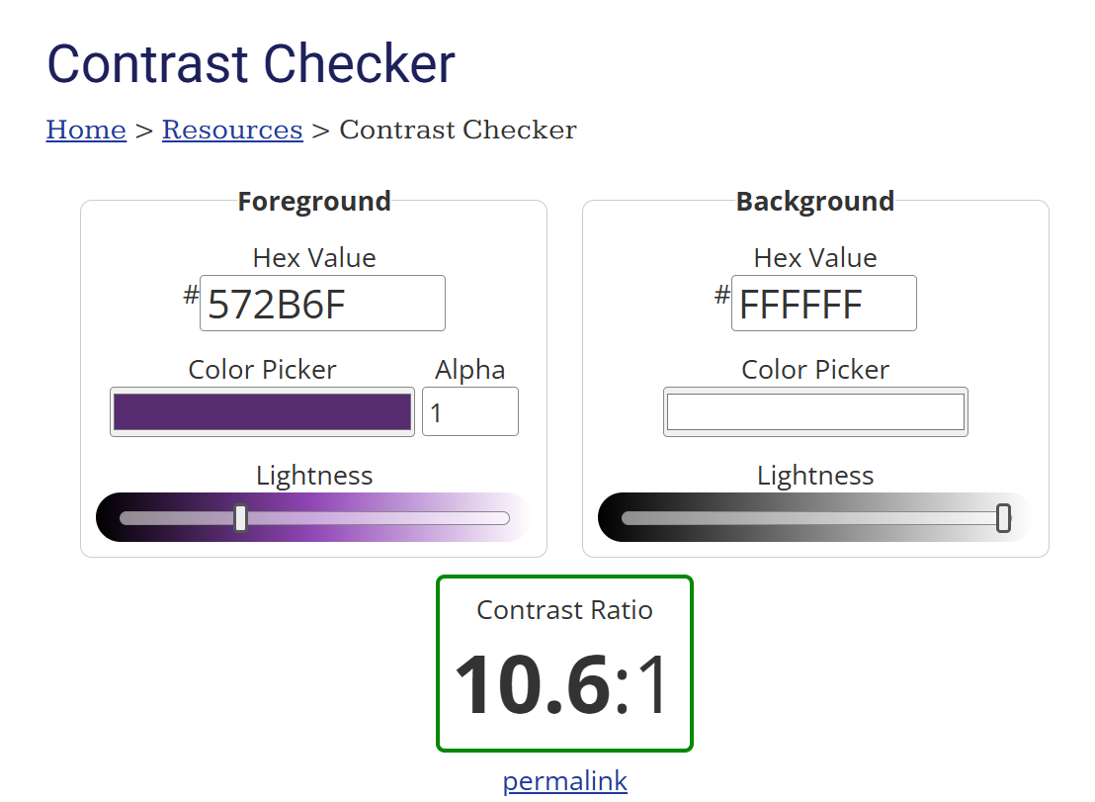
Tools for contrast
https://webaim.org/resources/contrastchecker/
Compare two colours (foreground and background)
Check against WCAG criteria for normal and large text, and graphical user interface components
Very well designed, accessible site

Slide 41
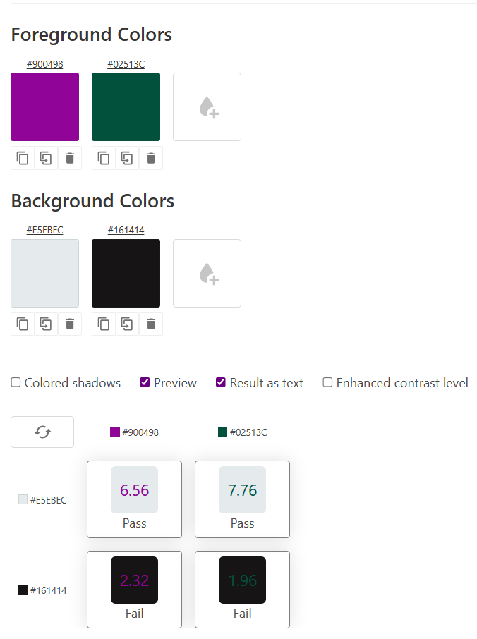
Tools for contrast
https://multiple-contrast-checker.netlify.app/
Useful for checking selections of colours
Doesn’t give you the same feedback on WCAG AA or AAA guidelines
Website text/UI is low-contrast

Slide 42
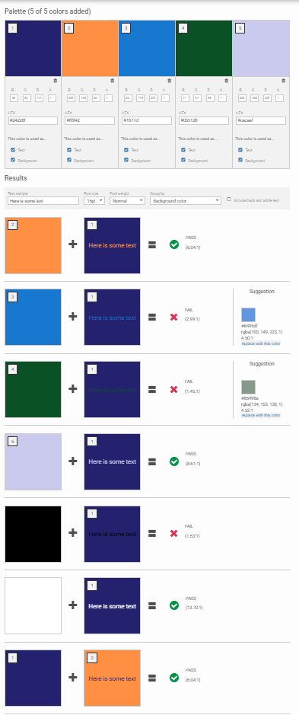
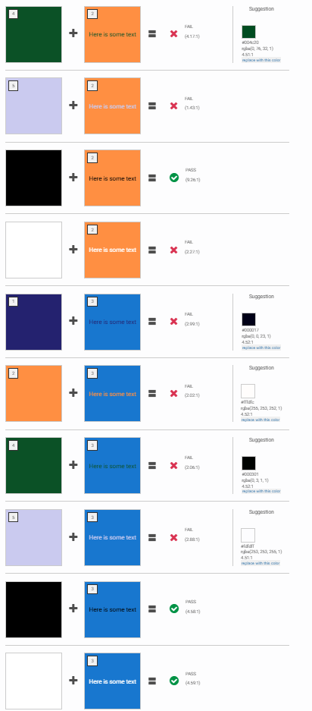
Tools for contrast
https://color-contrast-checker.deque.com/
Allows much more complex comparisons (of every colour with every other colour)
Suggests replacement colours for better contrast
A bit difficult to see all the comparisons: can be overwhelming

Slide 43
Contrast on maps
Treat labels, boundaries, lines as text when looking at contrast ratios (e.g. requiring high contrast)
Background colours underneath labels are often varied and not constant
Using halos/masks can make labels more legible
More discussion on typography later
Related reading:
11 Ways to Enhance Map Clarity with Strategic Labeling

Slide 44
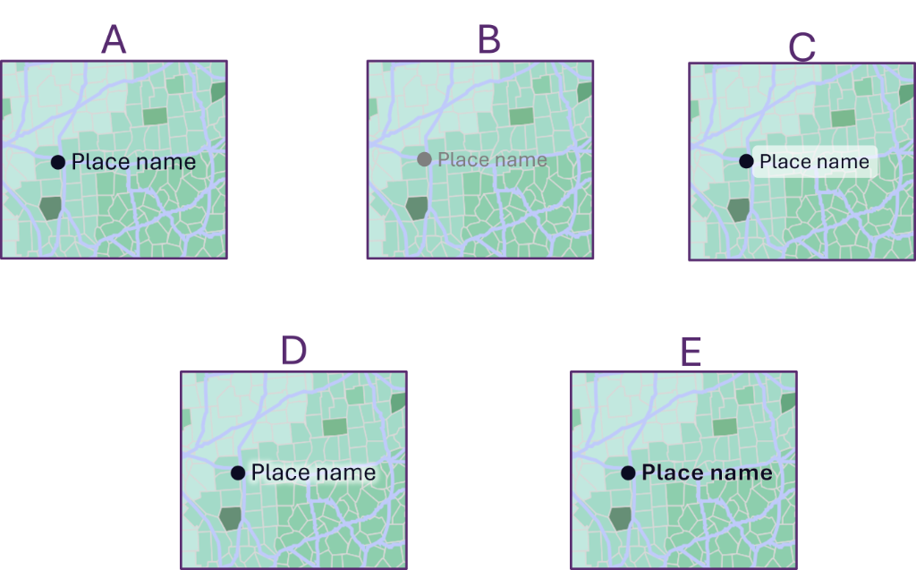
Which do you think are the WORST labels? Pick up to three
##/##
Join at: vevox.app
ID: 176-296-390
Question slide

Slide 45
Which do you think are the WORST labels? Pick up to three
##/##
Join at: vevox.app
ID: 176-296-390
Results slide

Slide 46
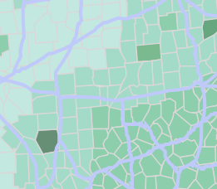
Contrast on maps
Treat labels, boundaries, lines as text when looking at contrast ratios (e.g. requiring high contrast)
Background colours underneath labels are often varied and not constant
Using halos/masks can make labels more legible
More discussion on typography later
● Place name
● Place name
● Place name
● Place name
● Place name
Related reading:
11 Ways to Enhance Map Clarity with Strategic Labeling

Slide 47
Contrast on maps
Colour being used to denote category:
Should contrast with lines/markers/labels
Should be differentiable from other regions
Use an alternative source of information: not just colour
Labels
Symbols
Tooltips/popups
If feasible, provide different basemap options or different colour options
No one-size fits all!
Related reading:
Designing a High Contrast Base Map for Users with Low Vision
11 Techniques for Making Maps More Accessible That Enhance Readability

Slide 48
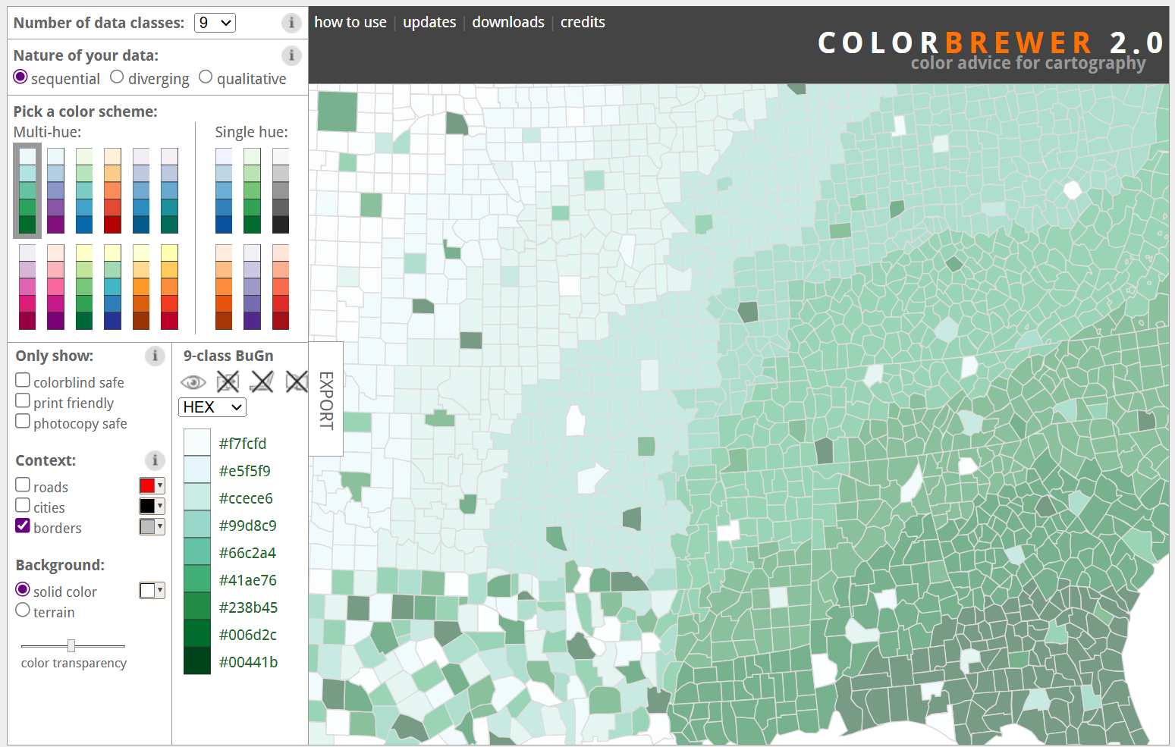
Low contrast

Slide 49
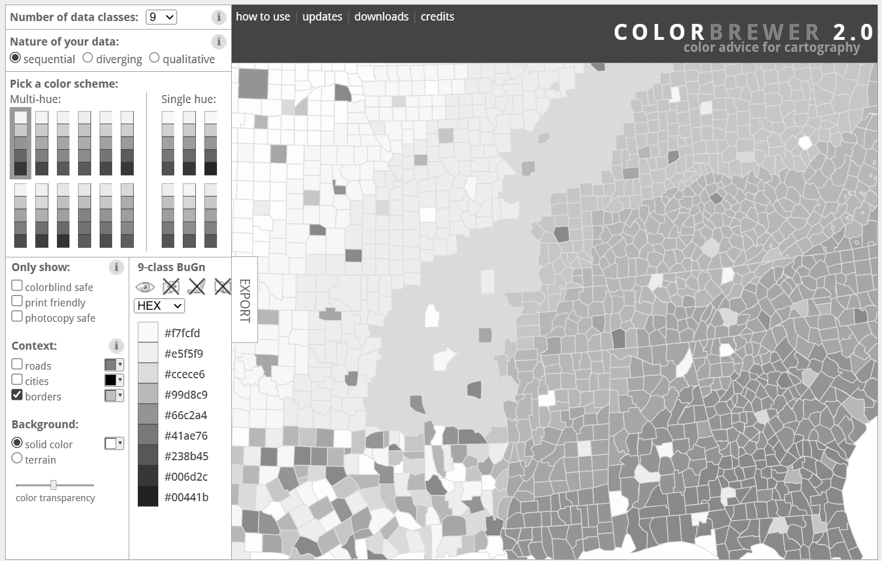
Low contrast

Slide 50
Tools for contrast on maps
https://colorbrewer2.org/ - allows you to pick different colour maps for different data class values
Lets you pick terrible options too – ensure to test colour choices with a contrast checker
https://datavizcontrast.com/ - allows you to find contrast levels for different line thicknesses
Useful for choosing colours for linear features
https://projects.susielu.com/viz-palette - Shows different plots of colours side-by-side with different filters
Great for maps and for other visualisations

Slide 51
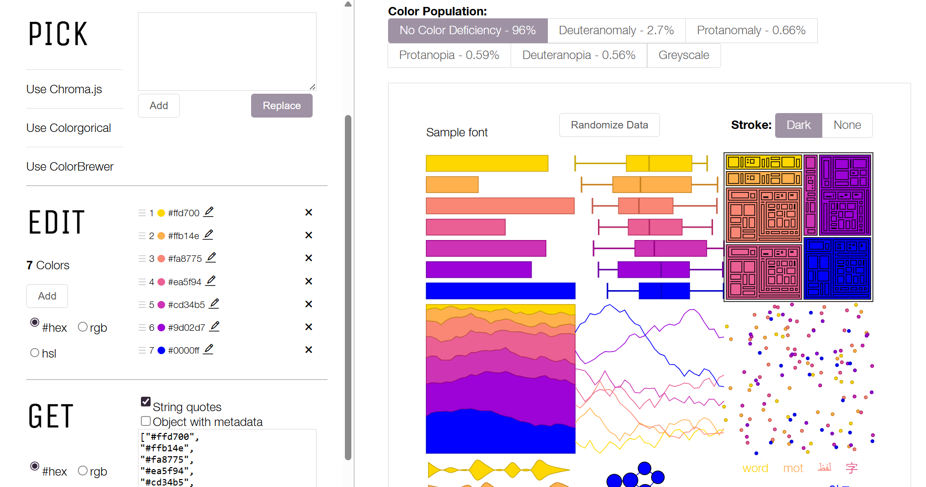

Slide 52
Fonts
Simple, familiar, easy-to-read
Avoid fonts with character complexity or ambiguity
Limited number of fonts
Disagreement over serif vs. sans serif
Minimum ~16 px
Using system fonts
Gives the user control/flexibility
Does mean you have a less control over appearance
Related reading:
Typefaces and Fonts
Accessible fonts and readability: the basics

Slide 53
A
B
C
I l 1
I l 1
I l 1
D
E
F
I l 1
I l 1
I l 1

Slide 54
Join the Vevox session
Go to vevox.app Enter the session ID: 176-296-390 Or scan the QR code

Slide 55
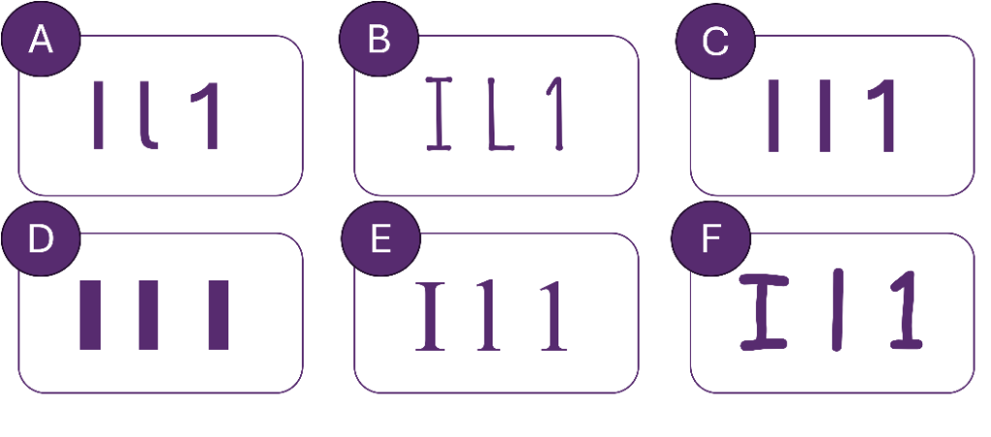
Which font is the most legible in this example?
##/##
Join at: vevox.app
ID: 176-296-390
Question slide

Slide 56
Which font is the most legible in this example?
##/##
Join at: vevox.app
ID: 176-296-390
Results slide

Slide 57
A
B
C
A long time ago in a galaxy far, far away…
A long time ago in a galaxy far, far away…
A long time ago in a galaxy far, far away…
D
E
F
A long time ago in a galaxy far, far away…
A long time ago in a galaxy far, far away…
A long time ago in a galaxy far, far away…

Slide 58
Fonts
Different fonts work best in different settings…
What if we let the user choose their own?

Slide 59
Fonts - advanced
Different ways to set font size on the web: rem, em, px…
Use CSS to set fonts:
Can use CSS in a separate .css file, or can use inline css
Can be accessed in plain html, or via various different frameworks in Python, R, etc.
Em vs. rem vs px?
px – exact pixel size of font; overrides browser settings
em – scale in relation to the font size of their parent element; can become complex with nesting
rem – scale relative to the root element’s font size
Related reading:
How to use rem units in CSS for accessible design

Slide 60
Fonts - advanced
rem units (root-em):
Users can specify a default font size in their browser, and elements that use rem units will respect this
A good idea for accessibility!
Pixel units: will override user’s default settings
Not good for accessibility!
Breaks zooming on desktop!
Related reading:
How to use rem units in CSS for accessible design

Slide 61
Zoomability
By using rem units for fonts, you make the page more zoomable
Pages not breaking when zoomed up to 200% is a key accessibility feature
Test zooming in and out of your website/webapp
Check mobile and desktop, zoom can be inconsistent!
Raise issues if your favourite framework makes it very difficult to zoom!
Related reading:
How to use rem units in CSS for accessible design

Slide 62
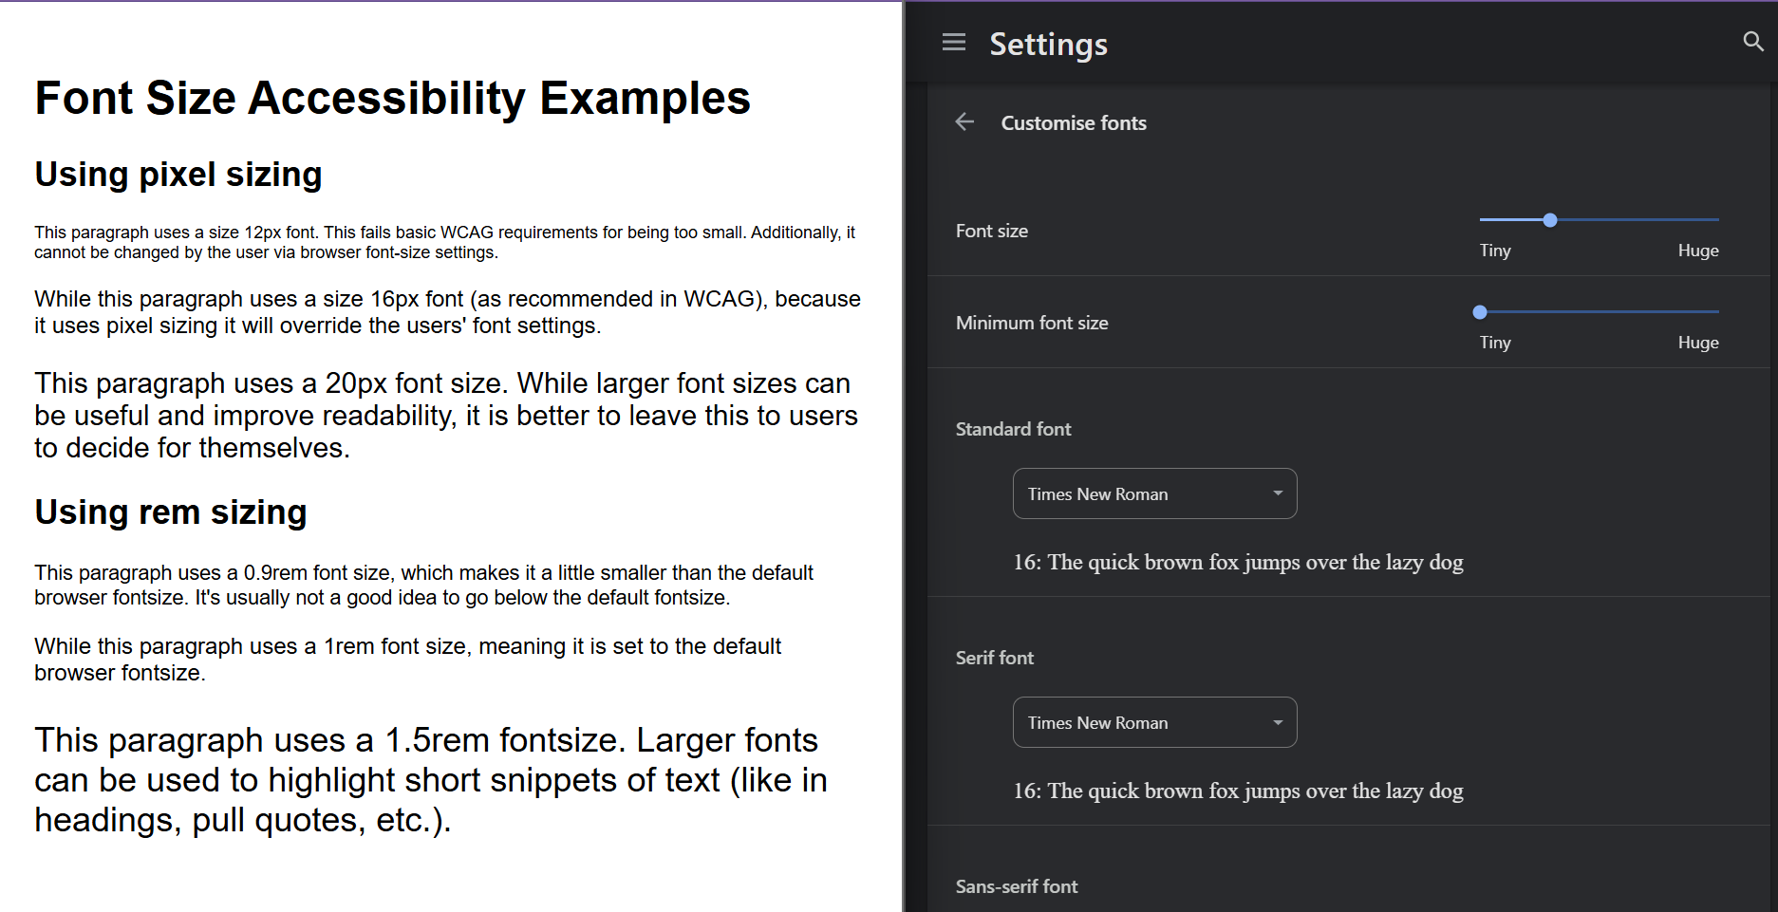
Demo See source on GitHub to see how to set css variables

Slide 63
Alt text
Ensure all visual elements such as images have alternative text
Videos should also have visual descriptions
But what should we add to a zoomable map that has a lot of complex information?
Take a few minutes to brainstorm ways of making interactive maps more accessible with alternative text
Example: https://leafletjs.com/examples/choropleth/example.html
Example 2: https://www.datawrapper.de/maps/choropleth-map

Slide 64
Join the Vevox session
Go to vevox.app Enter the session ID: 176-296-390 Or scan the QR code

Slide 65
How might you facilitate alt-text in an interactive map?
##/##
Join at: vevox.app
ID: 176-296-390
Question slide

Slide 66
How might you facilitate alt-text in an interactive map?
##/##
Join at: vevox.app
ID: 176-296-390
Results slide

Slide 67
Alt text for maps or charts
Providing a more extensive detailed description that explains key points and correlations
If you were to describe the plot/chart/map over the phone (or on a science podcast!) how would you describe it?
What are the key take-home messages?
While alt-text for images should be brief, for complex visualisations you need more information!
Keep description neutral and objective
Provide alternative formats…
Related reading:
Text descriptions for data visualisations
Making analytical publications accessible
Best practice for writing alternative text for complex images

Slide 68

Alt text for maps or charts
Ensure you communicate the meaning of symbols as opposed to purely describing their appearance
“Circle, with a diamond in the centre rotated by 45 degrees from the vertical” vs.
“Cartoon compass symbol”
Consider cognitive load
Edit for clarity and test with users
Organise descriptions sensibly:
Start with general, broad-scale descriptions
Group information logically
Related reading:
Text descriptions for data visualisations
Making analytical publications accessible
Best practice for writing alternative text for complex images

Slide 69
Alt text for maps or charts
Practical approach: how do we implement?
For simple images, we use the alt-text HTML tag
There is no single correct approach:
https://www.w3.org/WAI/tutorials/images/complex/
https://accessibility.blog.gov.uk/2023/04/13/text-descriptions-for-data-visualisations/
Sometimes we need to use HTML tags; sometimes it is better to put it in the body text

Slide 70
Screen reader friendly websites
In addition to alt-text, there are other places to add text descriptions
Buttons, text inputs etc. have “label” attributes which tell the user what the element is for
Use them!
Search “accessible label for…” and then the name of the element in your chosen framework
Navigate your website with a screen reader: while you won’t be able to “emulate” being a screen-reader-user, it’s an important part of testing

Slide 71
Alternative formats
Alongside your maps or other visual displays, offer an equivalent alternative format
Downloadable tables of data
Summary statistics
Detailed data description
Think of the results, discussion, and conclusion section of a paper
Alternative base maps (to allow for higher contrast)
Download of map as an image/pdf for printing/zooming
Should an alternative format replace our chart as the primary format?

Slide 72
Recap: make your content perceivable
Contrast and colours
Labels
Fonts
Zoomability
Alt-text
Alternative data formats

Slide 73
Making sure your content is operable
Keyboard navigation
Avoid rogue custom buttons
Semantic HTML

Slide 74
Keyboard navigation
Lots of users navigate using a keyboard or assistive tech that interacts with the web like a keyboard
Speed and efficiency
Motor-skills and accuracy
Fatigue
Need to ensure that all the same functionality that can be accessed with a mouse is available to users via a keyboard

Slide 75
Exercise on tab order
Visit content here: https://murphyqm.github.io/foss4g-uk-2025/accessibility.html
Explore the page by clicking and by tabbing
Which cause issues?
After the course, you can have a look at the underlying code

Slide 76
Join the Vevox session
Go to vevox.app Enter the session ID: 176-296-390 Or scan the QR code

Slide 77
Which elements are BAD?
##/##
Join at: vevox.app
ID: XXX-XXX-XXX
Question slide
##.##%
Element 1
##.##%
Element 2
##.##%
Element 3
##.##%
Element 4
##.##%
Element 5
##.##%
Element 6
##.##%
Element 7
##.##%
Element 8
##.##%
Element 9
##.##%
Element 10

Slide 78
Which elements are BAD?
##/##
Join at: vevox.app
ID: XXX-XXX-XXX
Results slide
##.##%
Element 1
##.##%
Element 2
##.##%
Element 3
##.##%
Element 4
##.##%
Element 5
##.##%
Element 6
##.##%
Element 7
##.##%
Element 8
##.##%
Element 9
RESULTS SLIDE
##.##%
Element 10

Slide 79
Keyboard navigation
Do the “no mouse” test on web applications
Note any buttons/interactivity that you have issue with
Use standard buttons/elements wherever possible
Avoid rogue custom buttons!
HTML elements have been designed with accessibility in mind
You can style them how you wish with CSS
Using span or div elements as custom buttons often leads to accessibility issues
Check that map elements can be focused with the keyboard

Slide 80
Keyboard navigation
Skip links help users navigate busy content
Often at the top of pages to skip navigation
Hidden from mouse interaction, and only show when using the keyboard
Jump to the start of the “main” content
If you have a map with many, many interactive and focusable elements, this may also be somewhere for a skip link
See https://murphyqm.github.io/foss4g-uk-2025/accessibility.html
<div style="outline:none" tabindex="-1">
<a href="#main-content" class="page__content-skip-link">Skip to main content</a>
</div>

Slide 81

Semantic html
HTML is the skeleton of the house
Trying to navigate a website with poorly structured html is like trying to make your way through an Escher painting or a funny house filled with warped mirrors!
Especially when using a screen reader or other assistive technology!
Need semantic html to avoid this
Fair use, https://en.wikipedia.org/w/index.php?curid=3475224

Slide 82
Semantic HTML
Semantic elements are elements with defined meaning
Semantic elements:
<img>
<h1>
<button>
<select>
<header>
<nav>
Non-semantic elements:
<div>
<span>
Related reading:
HTML Semantic Elements
Semantic HTML

Slide 83
Semantic HTML
Use pre-designed, standard buttons
Users know what to expect, how to interact with them
Less likely to fail basic accessibility guidelines
Ensure that you assign labels where required
Check that your Python or R code is outputting sensible HTML
Sometimes there can be issues with inputs/interactive elements

Slide 84
Making sure your content is understandable
Semantic HTML
Logical choices for design
Sensible alt-text
Alternative formats
Link names
We’ve already solved a lot of these issues in the P and O sections!

Slide 85
Semantic HTML
Use heading levels as actual heading levels, not aesthetic choices!
Use H1, H2, H3 etc. in order to denote main headings, sub-, and sub-sub-headings
Use CSS to style text for emphasis, not heading tags!
Organise the flow of your content sensibly
Use main, body, aside etc. tags
If designing on a grid, make sure the html order makes sense (as opposed to only making sense when arranged with CSS)

Slide 86
Sensible alt-text
Outside of purely technical descriptions, alt text should also help the user understand the topic
Describe the patterns seen – what are the key take-aways
Instead of focusing on aesthetic choices, ensure the message is understandable
Use unambiguous, clear language

Slide 87
Alternative formats
We briefly covered this before, but…
Is an image or graphic really the best choice?
Would a more accessible alternative actually be better?
Can a user fully understand the content from an alternative format?

Slide 88
Link names
Link text should make sense when read out of context
Screen reader or keyboard navigation users will often skip from link to link or experience all links on the page in a list format
Examples to avoid (underlined words are the link)
Read more
Click here to read our docs
Studies show that x, y, z…
Read through some examples
Better links:
Read more about X
Read our docs
Browse examples of x, y, z…
Studies show x, y, z

Slide 89
Making sure your content is robust
Custom functions vs. semantic HTML
Does it require a special piece of tech to work?

Slide 90
Avoiding very custom solutions
Custom-built workarounds to accessibility issues can cause problems if not well-maintained
Relying on well-established standards is a better idea!
Semantic HTML
Applications that have accessibility statements/docs/tutorials
Try to build for both mobile and desktop where possible
Don’t assume only small screens are touch-operated

Slide 91
Make sure the content works in different browsers
When designing for web, ensure you test the webapp on different browsers
Just because there is a market lead in a specific browser, it doesn’t mean that this is reflective of the disabled community
Browser | User share
Chrome | 66.45%
Safari | 16.61%
Edge | 5.35%
Firefox | 2.52%
Samsung Internet | 2.21%
Opera | 2.09%
Android | 1.31%
UC Browser | 0.9%
Brave | 0.85%
Other | 1.72%

Slide 92
POUR: the 4 principles behind WCAG
Perceivable: can the information be accessed via the browser or assistive technologies?
Operable: can users interact with all elements equally whether using a mouse, the keyboard, or an assistive device?
Understandable: is the content clear, equally understandable whether a user is using assistive technologies, and does it limit confusion and ambiguity?
Robust: does the website work for a wide range of technologies, instead of relying on very specific tech?
Related reading:
WebAIM: Introduction to Web Accessibility
Web Accessibility Initiative: Diverse Abilities and Barriers

Slide 93
Search for accessibility docs for your platform
Mapping libraries:
https://leafletjs.com/examples/accessibility/
Accessibility testing:
https://github.com/dequelabs/axe-core

Slide 94
Workshop content
What is web accessibility?
Where do we start?
How do we make web applications and maps more accessible?
How do we test our maps/apps for accessibility?
What are some hazards to be aware of?
Where do we learn more?

Slide 95
Join the Vevox session
Go to vevox.app Enter the session ID: 176-296-390 Or scan the QR code

Slide 96
How would you test a web app for accessibility?
##/##
Join at: vevox.app
ID: XXX-XXX-XXX
Question slide

Slide 97
How would you test a web app for accessibility?
##/##
Join at: vevox.app
ID: XXX-XXX-XXX
Results slide
RESULTS SLIDE

Slide 98
Testing web apps for accessibility
Use a checklist
https://webaim.org/standards/wcag/checklist
https://www.digitala11y.com/wcag-checklist/
Do a no-mouse navigation
Check that all functionality is accessible via keyboard
Explore the page with a screen-reader
Only useful if you put the time in to learning how to use a screen reader correctly

Slide 99
Testing tools
Web accessibility tools:
WAVE: https://wave.webaim.org/
Example 1: (really good example) https://wave.webaim.org/report#/https://www.gov.uk/guidance/accessibility-monitoring-how-we-test
Example 2: (some issues) https://murphyqm.github.io/foss4g-uk-2025/
Exercise: try to find all the issues with this page
Do you manage to find anything that the automated testing missed?
https://murphyqm.github.io/foss4g-uk-2025/accessibility/html/bad-design.html
https://wave.webaim.org/report#/https://murphyqm.github.io/foss4g-uk-2025/accessibility/html/bad-design.html

Slide 100
Browser Tools
Firefox and Chrome have extensive developer tools available, which are very useful for accessibility testing
In Chrome, can emulate phone screens/different screen sizes
Can view accessibility tree
Can dig into issues raised by WAVE
Very useful if you haven’t written the HTML (using Rshiny etc.)

Slide 101
Testing web apps for accessibility
For large-scale, important web applications
Hire a professional, disabled, accessibility tester!
Simulating disability is not successful or accurate

Slide 102
Workshop content
What is web accessibility?
Where do we start?
How do we make web applications and maps more accessible?
How do we test our maps/apps for accessibility?
What are some hazards to be aware of?
Where do we learn more?

Slide 103
Not listening to feedback
Accessibility is a continuous process, not a destination
Best practices evolve
There is no one-size-fits-all
There will always be something to improve
Welcome feedback!
Feedback from one user struggling to use your website is more valuable than feedback/compliments from 50 people who find it easy!

Slide 104
Accessibility overlays: avoid!
Plugins/add-ons that purport to fix accessibility issues
Widely disparaged by the disabled community:
Don‘t fix basic underlying issues (contrast, messy html, lack of alt-text)
Add an additional layer of complication to the website, especially when trying to use assistive technology
Often centred around compliance instead of user needs
Broadcasts that accessibility was an afterthought
Related reading:
Should I Use An Accessibility Overlay?
Accessibility Overlay Widgets Attract Lawsuits

Slide 105
AI accessibility checker tools
Do not rely on these

Slide 106
Perfectionism
There is a LOT of work involved in making the web accessible
The same way there is a LOT of work in making research open and reproducible
It is absolutely worth the effort
Don’t let overwhelm make you bury your head in the sand!
A lot of us are “accidental” web developers without formal training
Keep “P. O. U. R.” on a sticky note on your monitor
The same way you spell-check your work, check through the basics

Slide 107
But know when you’re out of your depth
If a key planned output of your work is a dashboard…
That you hope will be widely used by the general public
That will deliver important information
maybe you do need someone with formal training in this area!
Hire web developers with public-service experience
Hire disabled web developers
Hire disabled web accessibility auditors

Slide 108
Incorrectly-used ARIA labels
ARIA or Accessible Rich Internet Applications add extra detail to websites, allowing for improved accessibility
Complex to implement correctly unless you actively use them to navigate
No ARIA – better than bad ARIA
Causes confusion and makes the page unreadable
Related reading:
ARIA guides

Slide 109
Workshop content
What is web accessibility?
Where do we start?
How do we make web applications and maps more accessible?
How do we test our maps/apps for accessibility?
What are some hazards to be aware of?
Where do we learn more?

Slide 110
Tutorials
Mozilla Accessibility docs: in general, the MDN docs are a fantastic resource; the accessibility docs are no different
Web Accessibility Initiative: these tutorials are a great step-by-step guide to implementing various accessible patterns
Automating Accessibility: How To Test for the 6 Most Common Accessibility Issues on Home Pages

Slide 111
General resources
UK Gov web design standards
UK Gov accessibility strategy
Web Content Accessibility Guidelines (WCAG) 2.2

Slide 112
Blogs/accounts
Bluesky accounts:
Accessibility Awareness: great random snippets that you learn a lot from!
Blogs:
Sarah L. Fossheim
This is not an endorsement of any of these accounts/views shared!

Slide 113
Join the Vevox session
Go to vevox.app Enter the session ID: 176-296-390 Or scan the QR code

Slide 114
What's one takeaway from today?
##/##
Join at: vevox.app
ID: XXX-XXX-XXX
Question slide

Slide 115
What's one takeaway from today?
##/##
Join at: vevox.app
ID: XXX-XXX-XXX
Results slide
RESULTS SLIDE

